Slide 1
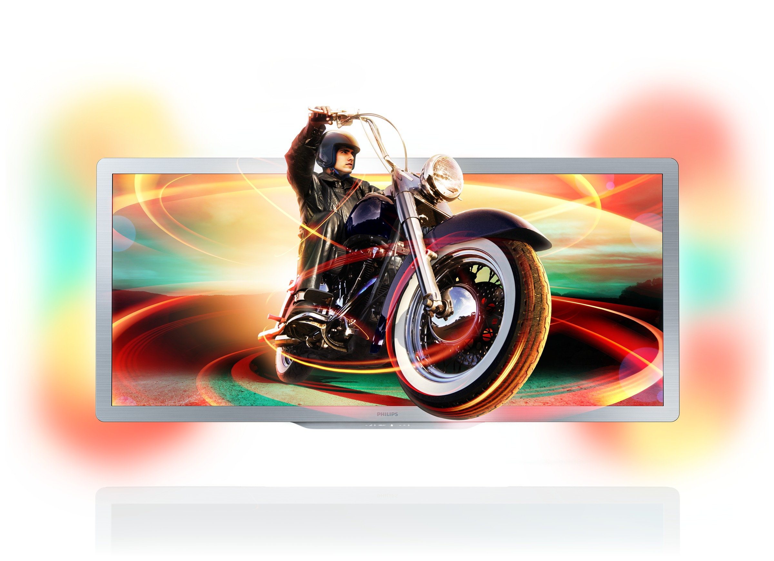
HVEI Special Session
Kjell Brunnström

Slide 2


HVEI Special Session@EI, Burlingame,CA, 29 Jan-2 Feb, 2017
”Visually Lossless Video Quality for modern devices: Research and Industry perspectives”
Presentations and panel discussion, 30 Jan 2017, 3:30 – 5:20 PM

Slide 3
HVEI Special Session@EI, Burlingame,CA, 29 Jan- 2 Feb, 2017
Image and video compression for mobile: Is my screen small enough? (Invited), Edward Delp, Purdue Univ. (United States)
Business perspectives on perceptually lossless and lossy quality (Invited), Scott Daly, Dolby Laboratories (United States)
Usage perspectives on perceptually lossless and lossy quality and assessment (Invited), Philip Corriveau¹, Juliana Knopf¹, Hannah Colett¹, and Shun-nan Yang²; ¹Intel Corporation and ²Pacific University (United States)
Subjective assessment and the criteria for visually lossless compression (Invited), Laurie Wilcox¹, Robert Allison², and James Goel³; ¹York University and ³Qualcomm (Canada)
Masked detection of compression artifacts on laboratory, consumer, and mobile displays (Invited), Yi Zhang, Yusizwan Yaacob, and Damon Chandler, Shizuoka University (Japan)

